Slide 1
REKTAURANT
Augmented Reality Food Menu

Slide 2
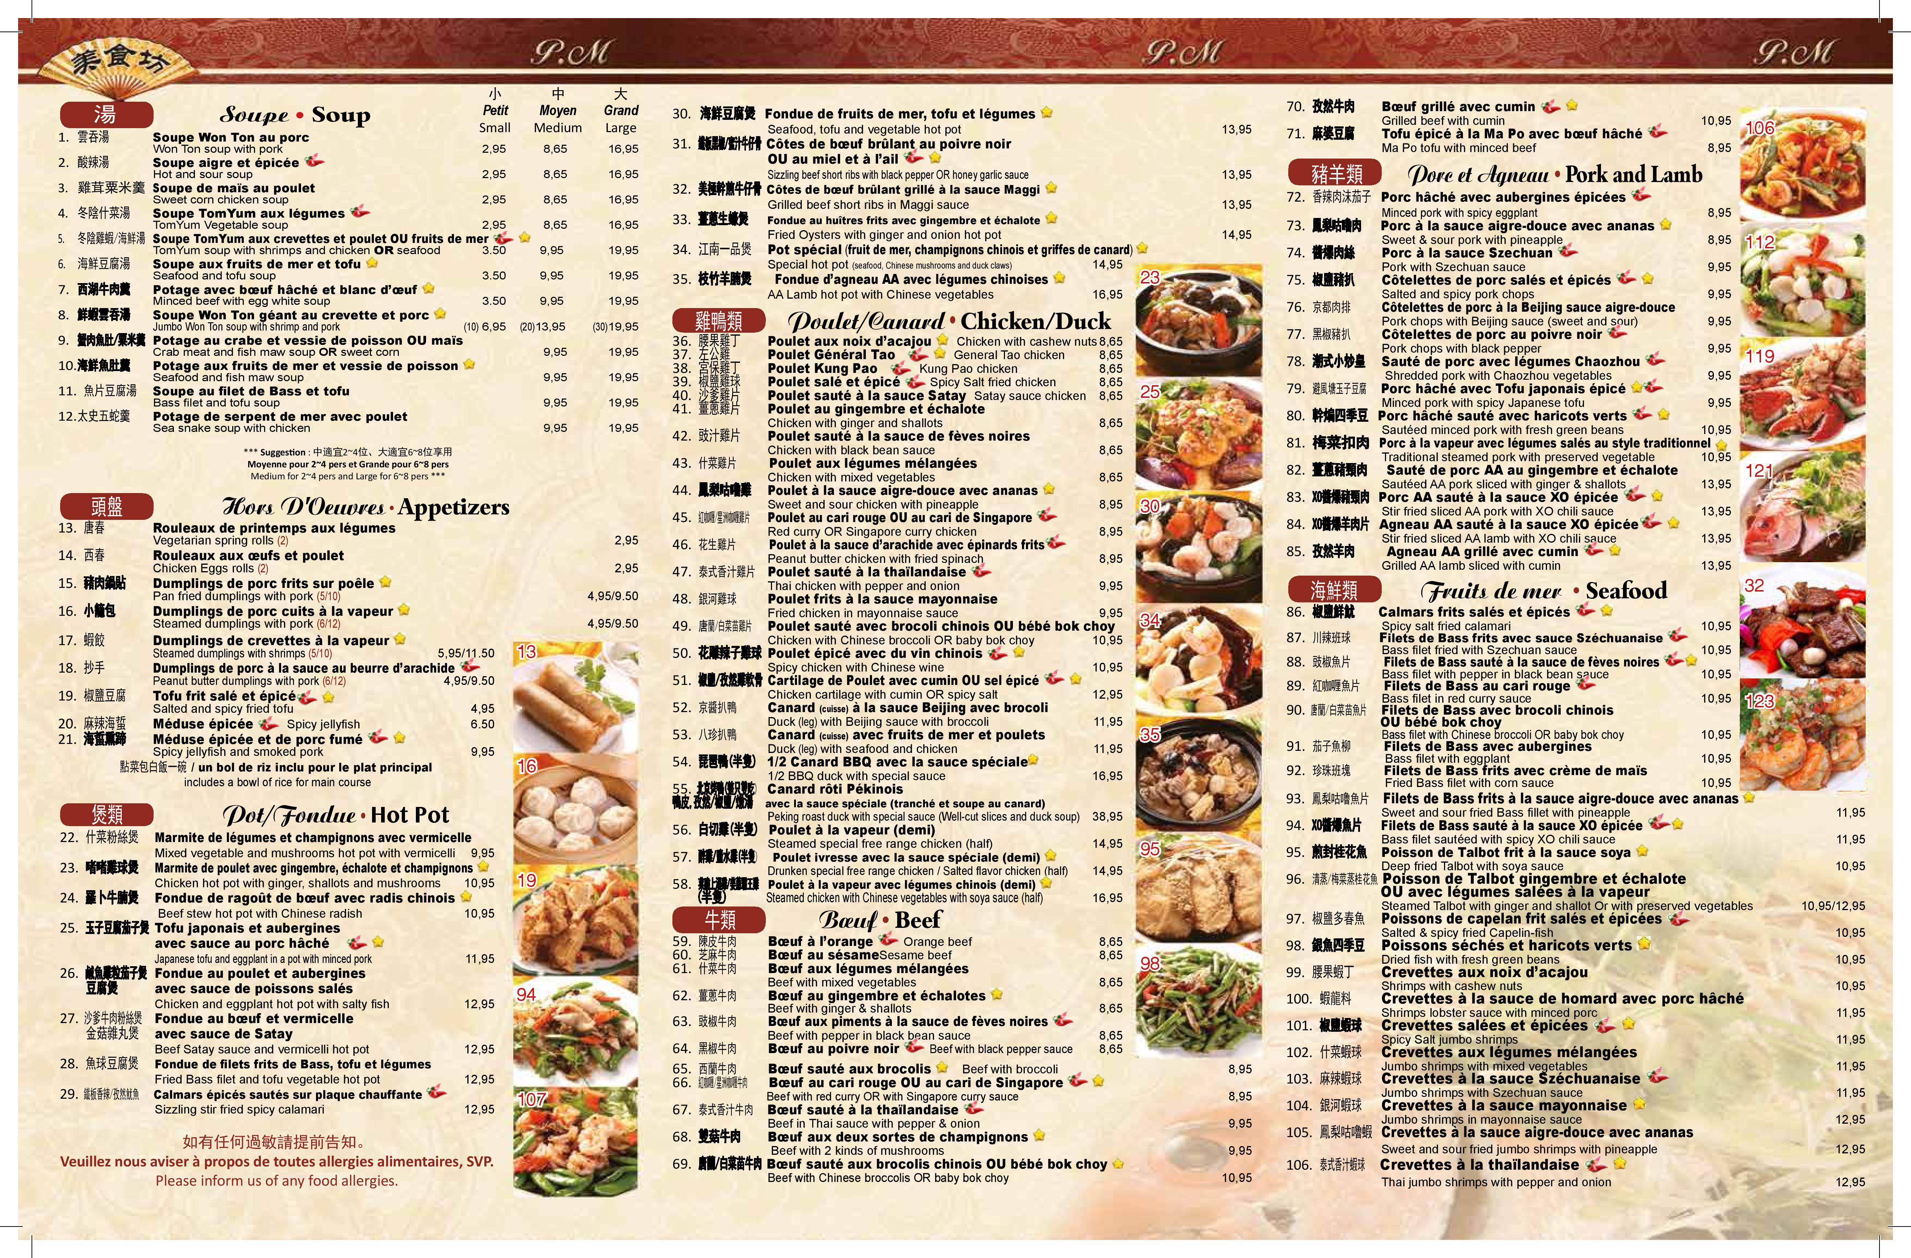
Notes:
Script: Vision document
---------------
The problem of: Boring ordinary 2D menu
Affects: Customers and restaurants
the impact of which is: Customers cannot imagine what the food really looks like and become unsatisfied as the food is
not like expected. Restaurants lose customers
a successful solution would be:
Gain more interest of customer thereby attracting more customers. Customers make the right choice of what they want

Slide 3
Problem Statement
Traditional Menu
Customers do not know what the actual dishes look like
Boring
Get bored while waiting for food
Inefficient due to human intermediates
Notes:
Script: Vision document
---------------
The problem of: Boring ordinary 2D menu
Affects: Customers and restaurants
the impact of which is: Customers cannot imagine what the food really looks like and become unsatisfied as the food is
not like expected. Restaurants lose customers
a successful solution would be:
Gain more interest of customer thereby attracting more customers. Customers make the right choice of what they want

Slide 4




Slide 5
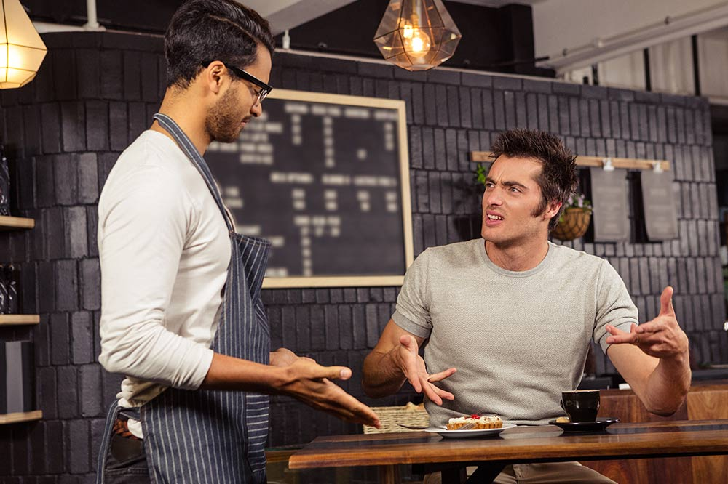

Users
Restaurant Customers
Restaurant staffs

Slide 6
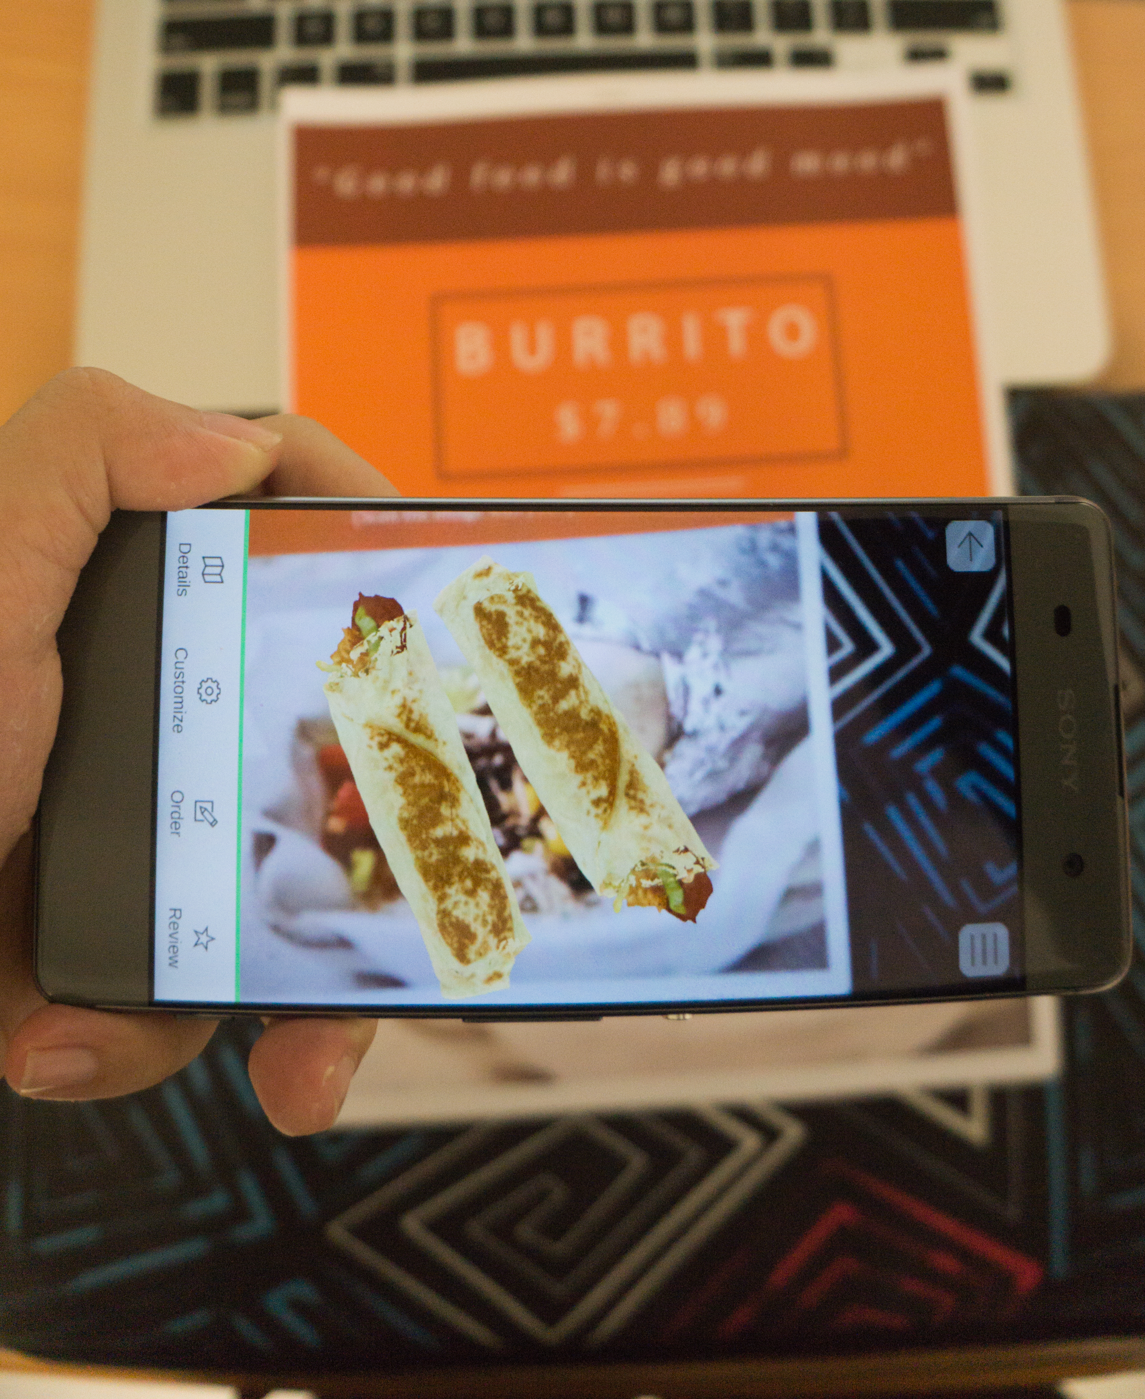
Product Position Statement
Provide realistic interactive virtual 3D food models with:
Detail descriptions
Clear ratings/reviews
Unlike boring ordinary menus containing plain text and 2D images
Notes:
Script: Vision Document
----------------
For: Customers and restaurants
Who : want to make better food choices and want to attract more customers respectively
The AR food menu: is a mobile application on Android operating system
That:
enables customers to see realistic virtual 3D models of dishes with detailed information about the ingredients included and how the plate is presented. In addition, there are also visualized ratings and reviews for each dish that customers can take into account when making decision. In addition, users can order their dishes directly using the application and the restaurant staffs can checkout as well as modify/view orders
Unlike: Ordinary menus which only contain 2D images and plain text
Our product: Provide 3D model of a dish that can be interacted with users.

Slide 7
Benefits
Traditional Menu
Customers do not know what the actual dish looks like
Boring
Get bored while waiting for food
Inefficient due to human intermediates
Augmented Reality Menu
Realistic virtual 3D models provide better experiences
Beautiful ARMenu attracts more customers to the restaurant
Give customer a way to spare their time
Use technology to enhance the process

Slide 8
Team Structure & Responsibilities
Team Lead & Designer: Khac-Tuan Nguyen
Main Developer: Bao-An Nguyen Tang
Main Tester, Developer: Xuan-Vinh Nguyen
Main Developer: Phu-Khoa Nguyen

Slide 9
Team Structure & Responsibilities
Member | Role
Khac-Tuan Nguyen Team Leader & Designer | Write reports, monitor project, coordinate meetings. Design components, classes, structures of the application.
Bao-An Nguyen Tang Main Developer | Implement the application
Xuan-Vinh Nguyen Main Tester, Developer | Write test plan, implement test cases and test the application. Implement the application
Phu-Khoa Nguyen Main Developer | Implement the application

Slide 10
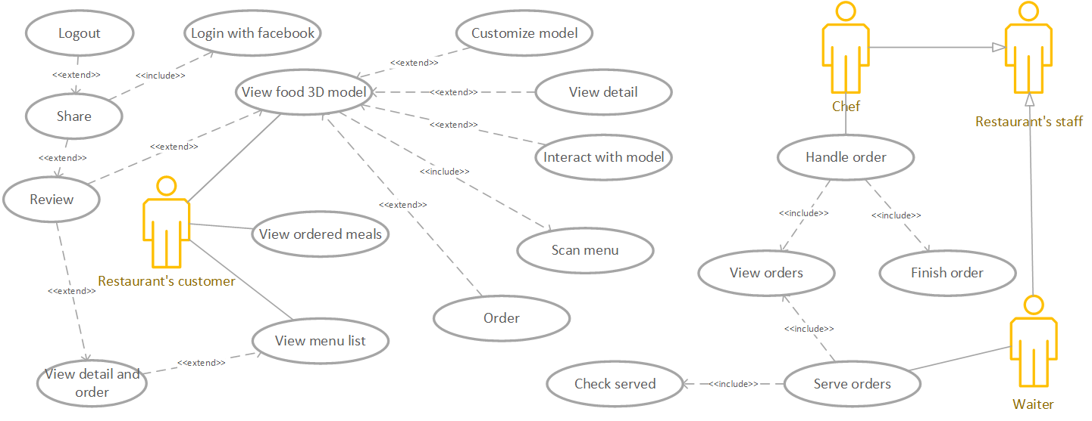
Use-case Model

Slide 11
Non-functional Requirements
Easy to use: clear, simple UI (not too many buttons)
Maintainable: take advantage of OOP
There should be 2-second delay when scanning picture for displaying 3D models
Mouth-watering food models
Simplify the work of Chef and Waiter: no more than 3 steps

Slide 12



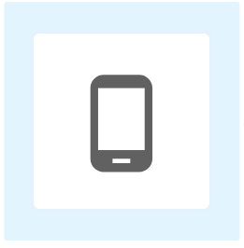
Architecture – Deployment View
Handle some functions on data changes
Push
information
Synchronize across devices

Slide 13
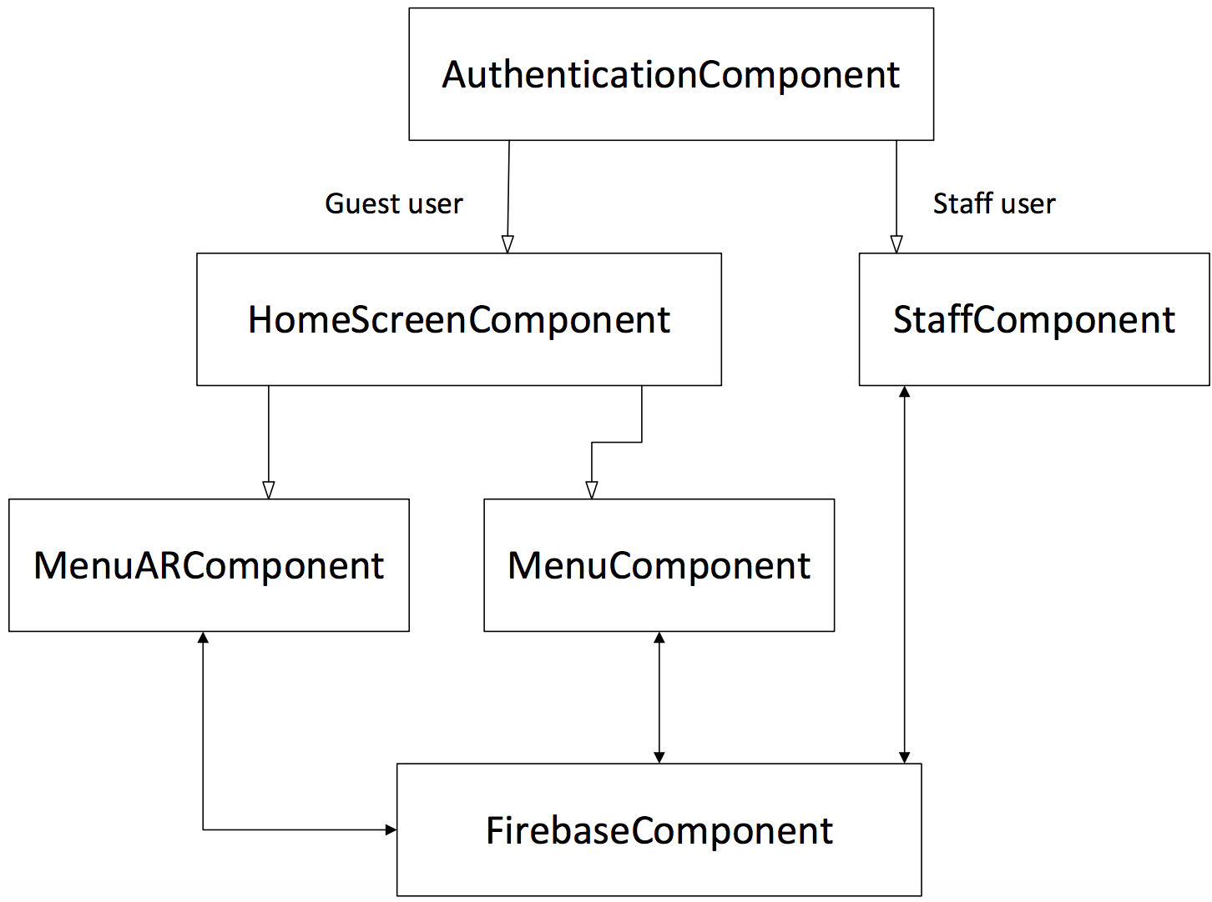
Architecture – Overview

Slide 14
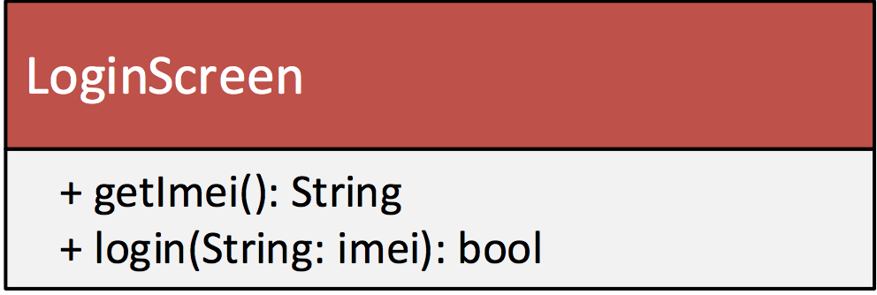
Architecture – Logical View
AuthenticationComponent

Slide 15
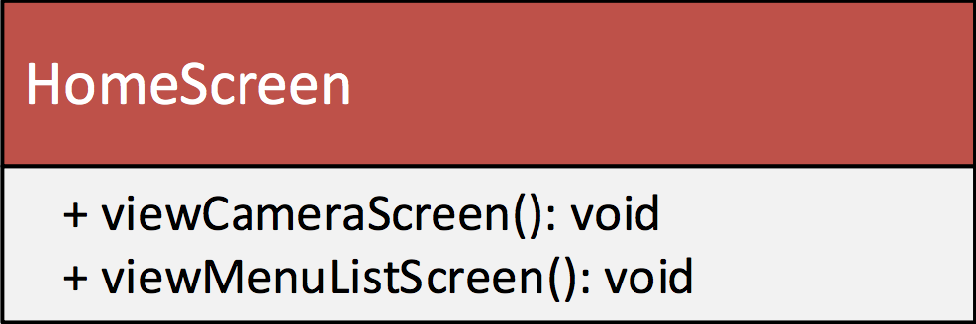
Architecture – Logical View
HomeScreenComponent

Slide 16
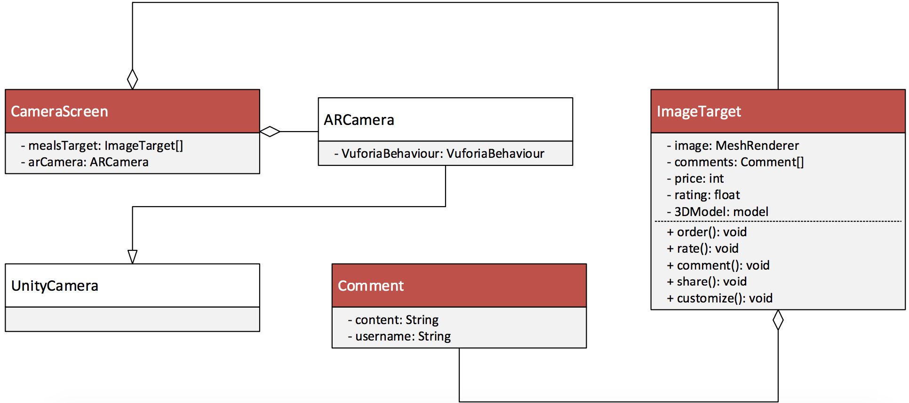
Architecture – Logical View
MenuARComponent

Slide 17
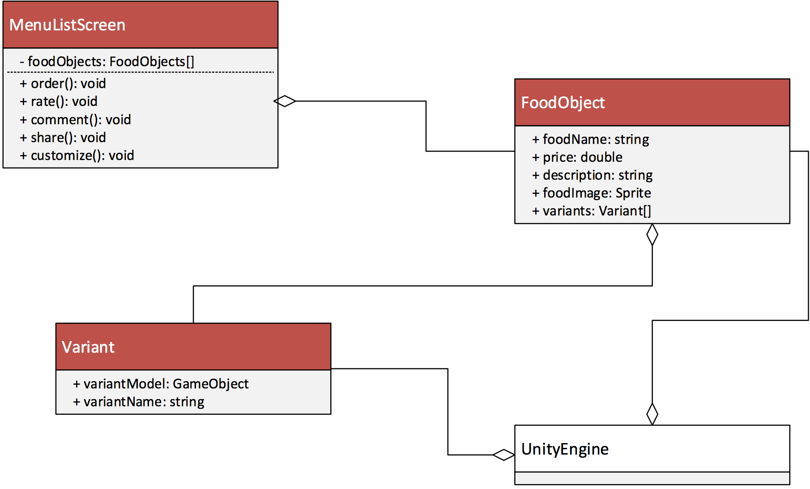
Architecture – Logical View
MenuComponent

Slide 18
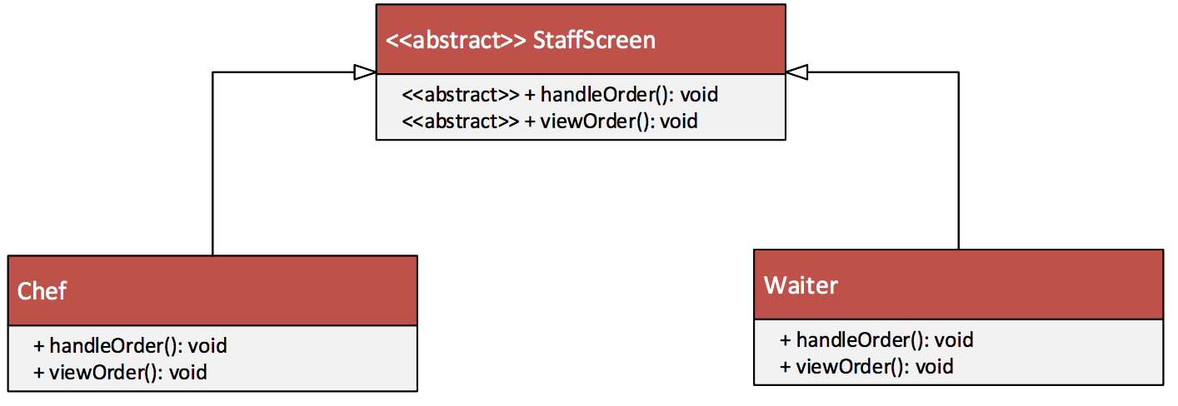
Architecture – Logical View
StaffComponent

Slide 19



Technologies Used
Notes:
Nhắc đến việc lúc đầu định sử dụng Java + Android Studio nhưng ít documents nên qua C# + Unity

Slide 20
Testing - Environments
Hardware Requirements
Operating system: Android 5.1 and above
Have Internet connection
- RAM > 1GB

Slide 21
Testing - Environments
Software in the Test Environment
Software Name | Purpose | Version | Type and Other Notes
Windows OS | Run Unity-built-in UITest Automation package for testing | 10, 64-bit | Operating System
Mac OS | Run Unity-built-in UITest Automation package for testing | 10.13.1 | Operating System
Android OS | Run the demo application | 6.0 Marshmallow, 7.0 Nougat, NOX Emulator | Operating System

Slide 22
Testing – Test Plan & Results
Target Test Item | Input | Expected Results | Actual Result
Login | Device’s IMEI | Specific scene corresponding to actor’s device displayed correctly | Specific scene corresponding to actor’s device displayed correctly
View 3D models | Target image (user scan target image with device’s camera) | 3D models displayed correctly | 3D models displayed correctly
Customize food | User input (user taps on variants) | Corresponding model of variant displayed correctly | Corresponding model of variant displayed correctly
Order food | User inputs | Order successfully | Order successfully

Slide 23
Testing – Test Plan & Results
Target Test Item | Input | Expected Results | Actual Result
View detail of dishes | User input (user taps on ”Detail” tab) | Detail description of the active food model displayed correctly | Detail description of the current food model displayed correctly
View order history | User input (user taps on “History” icon) | A list of ordered dishes displayed correctly | A list of ordered dishes displayed correctly
Review | User inputs | Review (rating/comment) successfully | Review (rating/comment) successfully

Slide 24
Testing – Test Plan & Results
Target Test Item | Input | Expected Results | Actual Result
View list of orders |  | List of ordered items displayed correctly based on actor’s device (distinguish between Chef & Waiter) | List of ordered items displayed correctly based on actor’s device (distinguish between Chef, Waiter & Guests)
View order’s detail | User input (user taps on an item in the list) | Detail information of the order displayed correctly | Detail information of the order displayed correctly
Process order | User input (user (chef or waiter) taps on button (“Cooked” or “Paid”)) | Process successfully and new list displayed correctly | Process successfully and new list displayed correctly

Slide 25
Testing – Test Plan & Results
Target Test Item | Input | Expected Results | Actual Result
View full list of dishes |  | List of supported dishes displayed correctly | List of supported dishes displayed correctly
Order food (in menu list) | User inputs | Order successfully | Order successfully
Review (in menu list) | User inputs | Same as previous review | Same as previous review
View order history | User input | Same as previous “View order history” result | Same as previous “View order history” result

Slide 26
IT’S DEMO TIME!!
Here comes REKTAURANT

